Slide 1
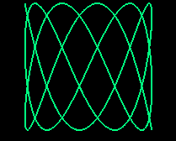
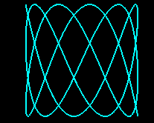

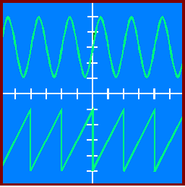
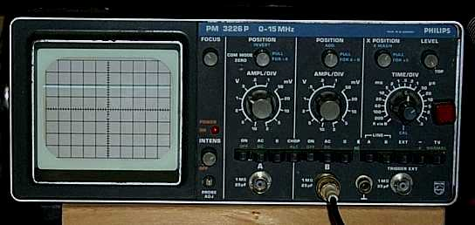
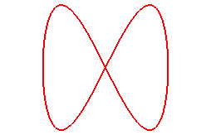

The Cathode Ray Oscilloscope

Slide 2
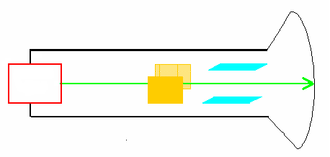
THE CATHODE RAY OSCILLOSCOPE
Vacuum
Fluorescent screen
electron
gun
X DEFLECTION
PLATES
Y DEFLECTION
PLATES
Electron Beam

Slide 3
Applying a pd across the x-plates
+
-

Slide 4
When a connection is made to the “y” plates the trace moves as shown
The “ y “ sensitivity is set at
5 V / Div
Is the time base switched on?
Is the signal AC or DC?
What is the applied p.d.?
2.5 Div x 5 V/Div = 12.5 V

Slide 5
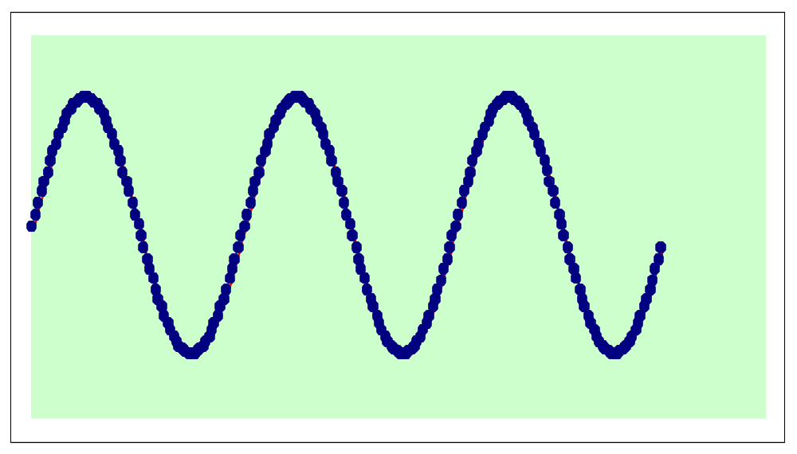
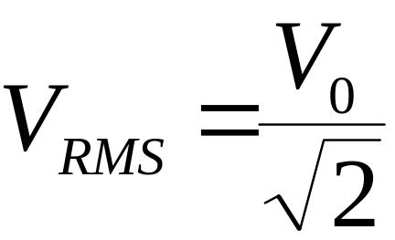
AC SIGNALS
Peak
V₀
V_{RMS}
Peak
to Peak
Reference

Slide 6
The “ y “ sensitivity is set at
5 V / Div
What is the
peak to peak
AC voltage ?
Peak to peak is
is 6 divisions
6 div x 5 V/div = 30 V

Slide 7
The “ y “ sensitivity is set at
20 V / Div
What is the
peak
AC voltage ?
3 div x 20 V / div = 60 V

Slide 8
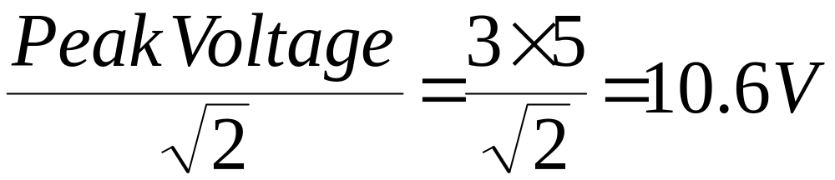
The “ y “ sensitivity is set at
5V / Div
RMS VOLTAGE ?

Slide 9
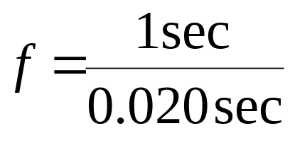
MEASURING FREQUENCY
The time base [sweep] is set at
5 ms / Div
What is the
frequency
of the signal?
One wave over four division = 4 x 5 = 20 ms = 0.020 s
Frequency equals ?
= 50 Hertz
f = waves in 1 sec

Slide 10
MEASURING TIME
The time base setting on the screen below is 5 s per division
What is the time interval between the pulses?
3.5 divs x 5  / div = 17.5 x 10⁻⁶ s

Slide 11
The “ y “ sensitivity is set at
1 V / Div
REFERENCE
WHAT IS THE SOURCE OF THIS TRACE ?

Slide 12
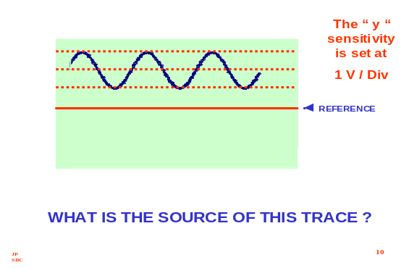
2V pp A.C.
~
CRO
2 V D.C.
0 V

